Slide 1
PERFOMANCE ANALYSIS OF FACEBOOK AD OF CAMPAIGNS FOR SUPERHERO U
Prepared by;
Marvin Ochieng
Brenda bochaberi

Slide 2
objectives
The primary objective of the campaign ad analysis is to identify most performing campaign ad audience groups and geography regions and recommend them to be continued

Slide 3
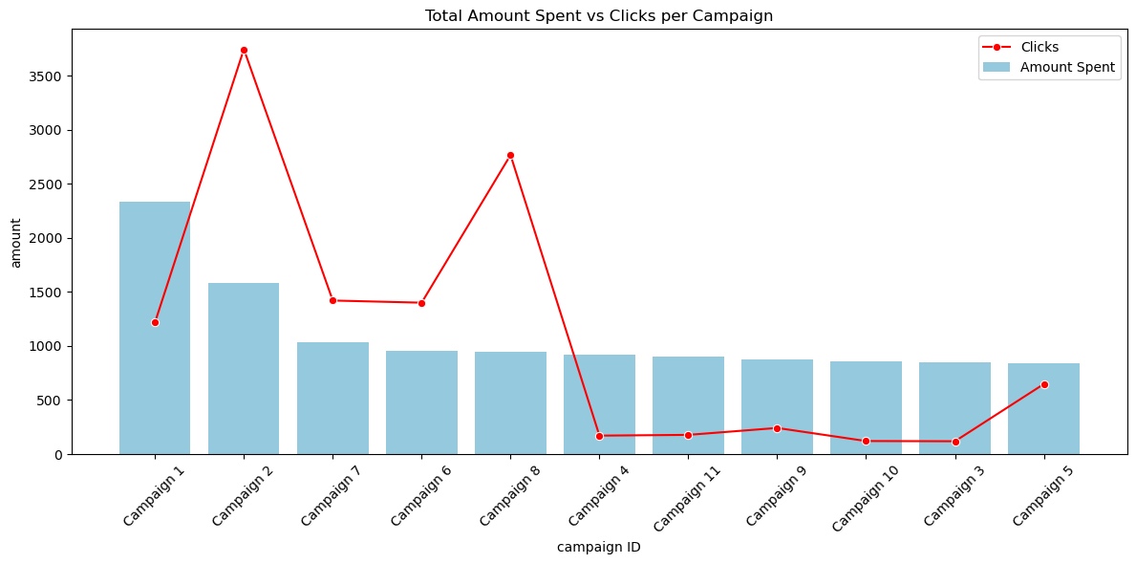
Total amount spent vs clicks per campaign id
Campaign 8 was the most performing amount of 1000$ was spent on it and it had almost 3000 clicks this indicates a positive engagement
campaign 2 spent around 1500 and it has the highest number of clicks of 3700

Slide 4
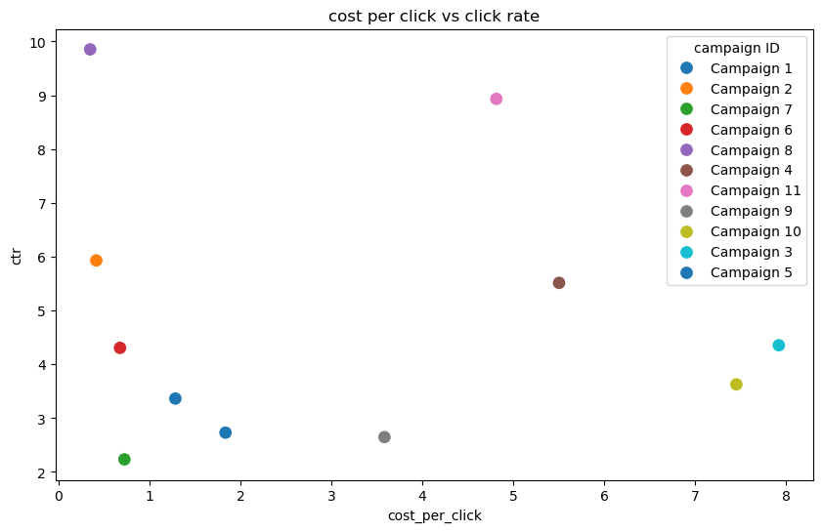
COST PER CLICK VS CLICK TROUGH RATE
Campaign 8 has the highest click through rate of around 10 with a low cost per click of 0.4 making it the most performing
Campaign 2 has a click through rate of 6 with a cost per click of 0.5 making it also a performing ad

Slide 5
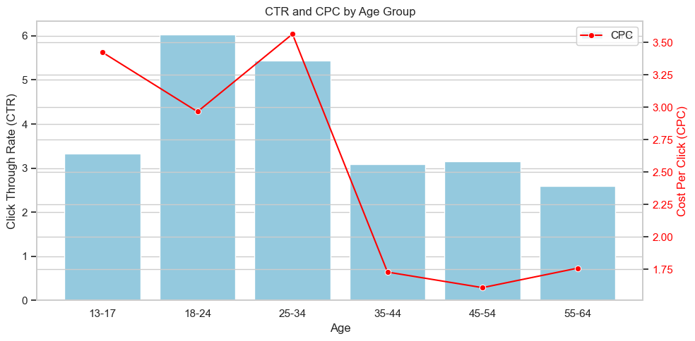
CLICK THROUGH RATE AND COST PER CLICK BY AGE GROUP
18-24 is the most engaging age group with costper click of 2.9 and click through rate of 6

Slide 6
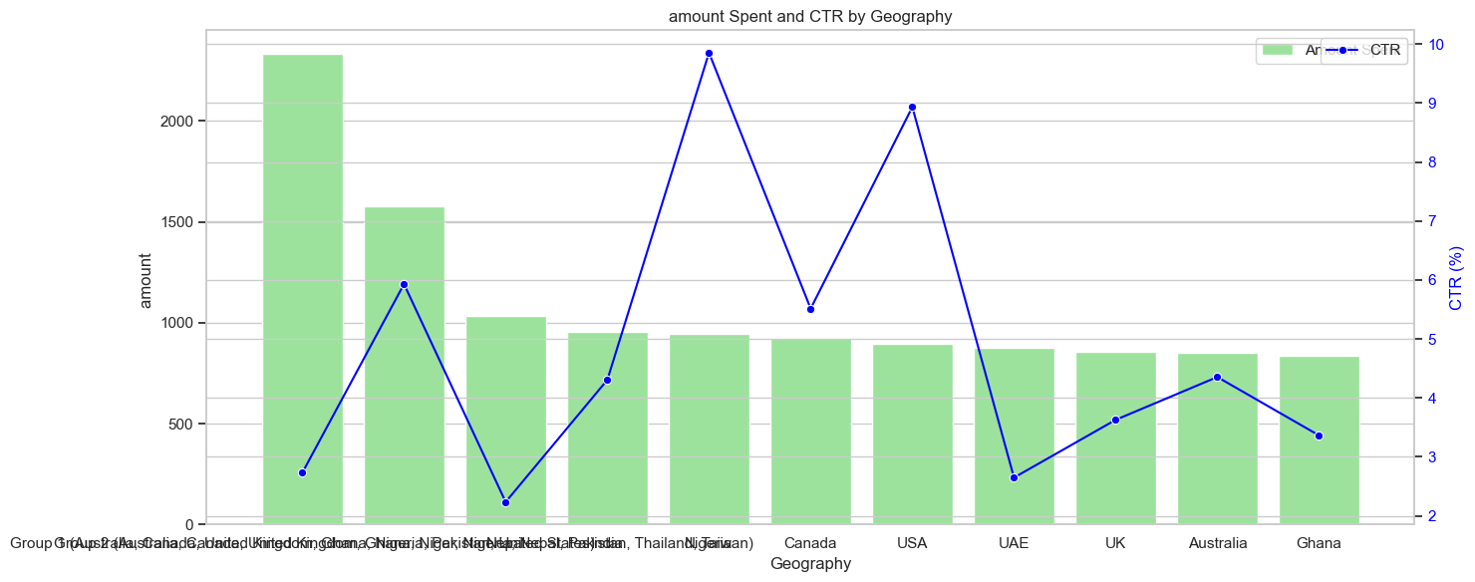
AMOUNT SPENT AND CTR BY GEOGRAPHY
Nigeria was the most performing country with a click though rate of 10 and amount spent was 940
Usa was the second most perfoming country with click rate of 9 and amount spent of 890

